Slide 1
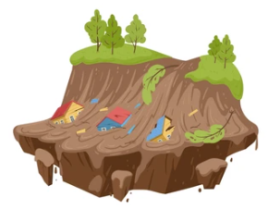
GLOBAL LANDSLIDES DATA PRESENTATION
Team #3: Samuel J. Klein & Damon M.W. Robinson

Slide 2
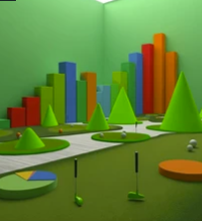
OUTLINE DESCRIPTION: DATA PRESENTATION
DATASET INTRODUCTION:
Detail the datasets first impression.
GATHERED DATA FROM: DATA.GOV
NASA - GLOBAL LANDSLIDE CATALOG
Determine if any relationships exist between: LANDSLIDE CATEGORIES, COUNTRIES, STORMS, INJURIES, and FATALITIES.
Discuss expected relationships:
DATA CORELATIONS.
Detail the RELEVANCE and LIMITATIONS of the provided dataset.
DATA DECISIONS OUTRO:
Explain the data methods used to GROUP and CLEAN the DATA. Reference any additional outside data sources that could provide greater real world meaning to the dataset.

Slide 3
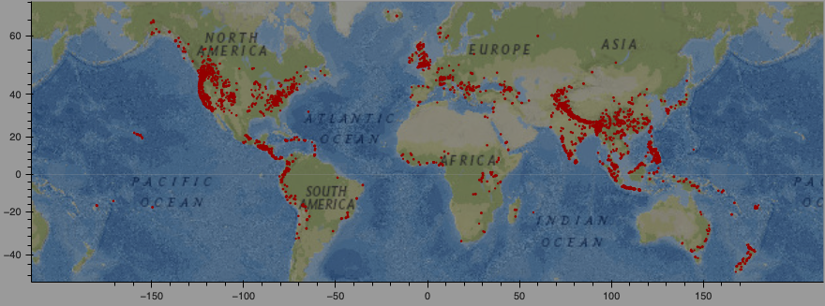
GLOBAL LANDSLIDE CATALOG
11033
140
1988 -2017
Recorded landslides
Countries
Range of years
Data sources:
D. B., Adler, R., Hong, Y., Hill, S., & Lerner-Lam, A. (2010). A global landslide catalog for hazard applications: method, results, and limitations. Natural Hazards, 52(3), 561–575. doi:10.1007/s11069-009-9401-4. [1]
Kirschbaum, D.B., T. Stanley, Y. Zhou (In press, 2015). Spatial and Temporal Analysis of a Global Landslide Catalog. Geomorphology. doi:10.1016/j.geomorph.2015.03.016. [2]

Slide 4
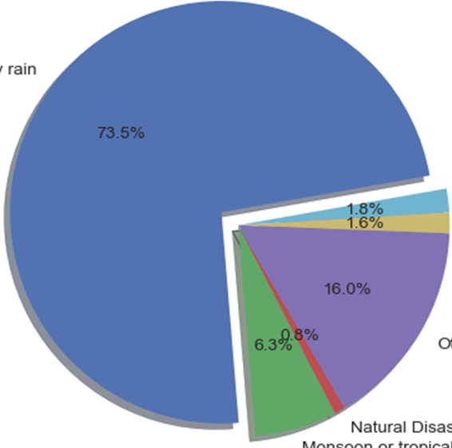
Total Recorded Landslide Data events:
Recorded Landslides 11,033 total events
Heavy Rains - 73.5% 8,095 events
Other/Unknown - 16% 1,717 events
Tropical Cyclones & Monsoons - 6.3% 690 events
Earth Work - 1.8% 197 events
Melt Thaw - 1.6% 176 events
Natural Disaster - 0.8% 91 events

Slide 5
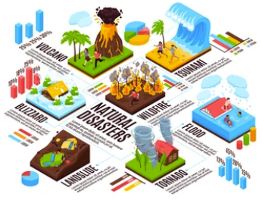
SEARCHING FOR EXPECTED DATA CORRELATIONS:
DEADLIEST LANDSLIDE BY COUNTRY CALCULATION:
COUNTRY * POPULATION * TOTAL LANDSLIDES * INJURIES * FATALITIES
IDENTIFYING DEADLIEST LAND MASSES:
INJURIES * FATALITIES * LONGITUDE * LATITUDE * COUNTRY * EVENT ID
DEADLIEST LANDSLIDE AREAS:
INJURIES * FATALITIES * LONGITUDE * LATITUDE * LANDSLIDE TRIGGER * LANDSLIDE CATEGORY
MOST VOLATILE SEASONS:
INJURIES * FATALITIES * EVENT DATE * EVENT TIME * LONGITUDE * LATITUDE * COUNTRY
MOST COMMON LANDSLIDE CAUSES:
LANDSLIDE TRIGGER * LANDSLIDE CATEGORY
TRACKING MONTHLY & ANNUAL SEASONAL TRENDS:
EVENT DATE * EVENT TIME * LONGITUDE * LATITUDE * COUNTRY
HISTORICAL TREND OF LANDSLIDE SIZE VS TIME OF YEAR:
LANDSLIDE SIZE * EVENT DATE * LONGITUDE * LATITUDE * COUNTRY

Slide 6

PROCESSING DATA INTO MEANINGFUL INFORMATION
(Information) Non-Numeric Columns Needing a Compatibility​ Factor
​
LANDSLIDE_SIZE
LANDSLIDE_CATEGORY
LANDSLIDE_TRIGGER
VERSUS
(Data) Numeric Columns That Do Not Need a Compatibility​ Factor
​
EVENT_DATE
EVENT_TIME
MONTH​
LONGITUDE
LATITUDE

Slide 7

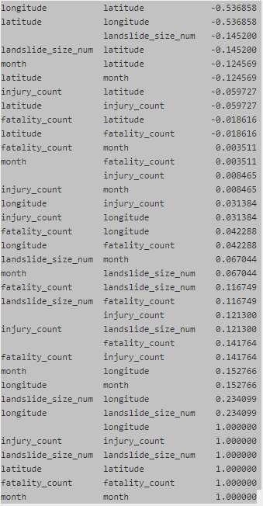

DATA CORRELATION MATRIX
How to tell a story using data with low correlation?
No moderate correlation (>0.3) other than Longitude & Latitiude

Slide 8
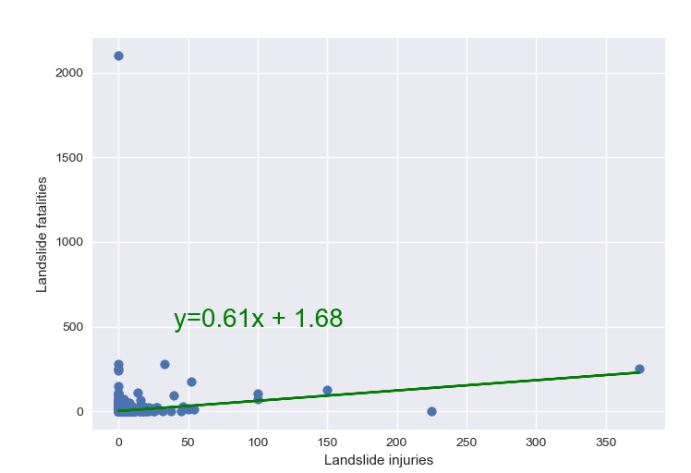
Data Correlation GLOBAL LANDSLIDE CATALOG
landslide_injuries |
fatality_count
r value: 0.1417644076243891

Slide 9
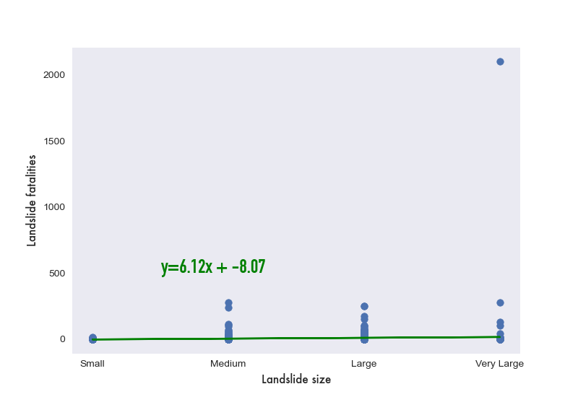
Data Correlation GLOBAL LANDSLIDE CATALOG
landslide_size |
fatality_count
r value: 0.11674872630789888

Slide 10
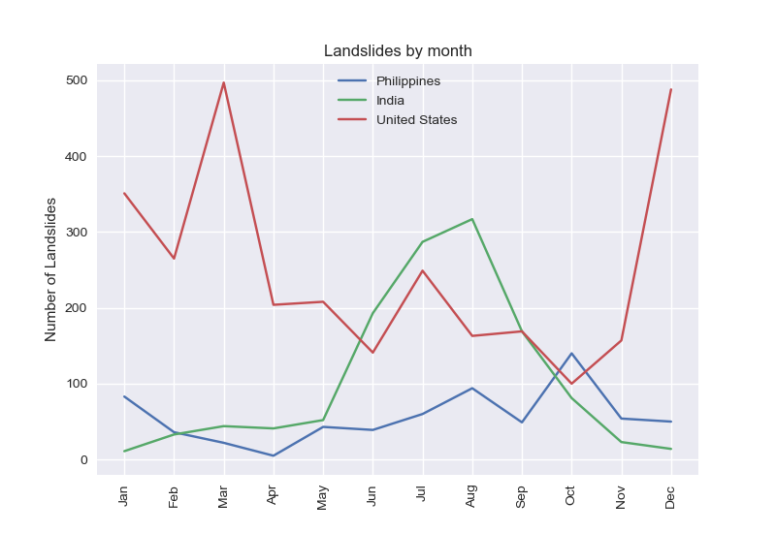
Landslides by month for top 3 countries .groupby("month")["event_id"].count().plot()

Slide 11
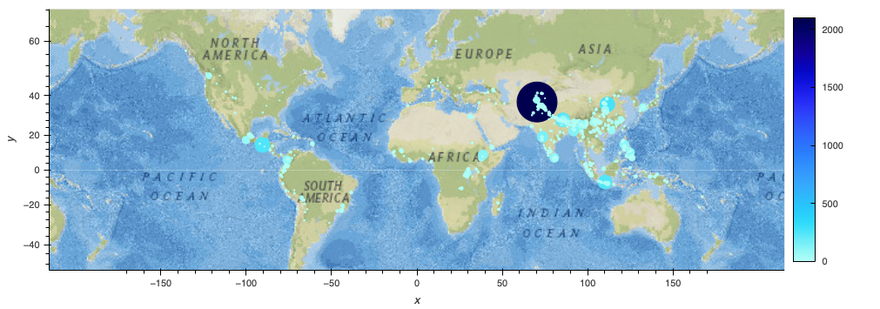
Landslide fatalities map .hvplot.points("longitude","latitude",geo=True,tiles="EsriNatGeo", color="fatality_count",size="fatality_count")

Slide 12
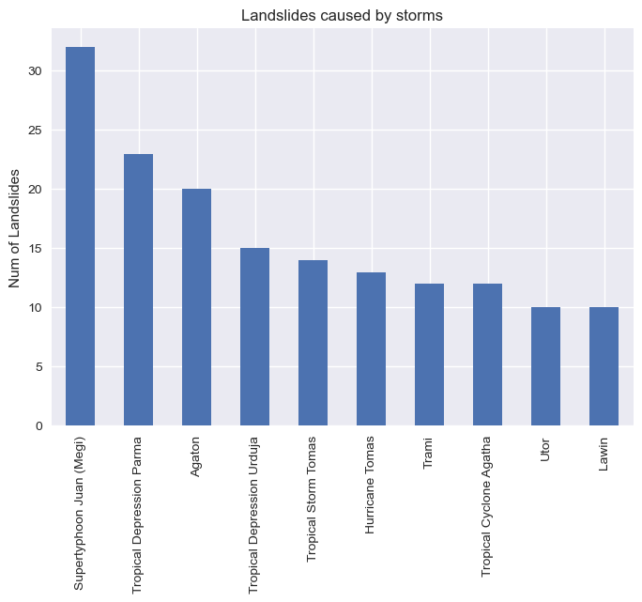
Top 10 storms that triggered landslides
GLOBAL LANDSLIDE CATALOG

Slide 13
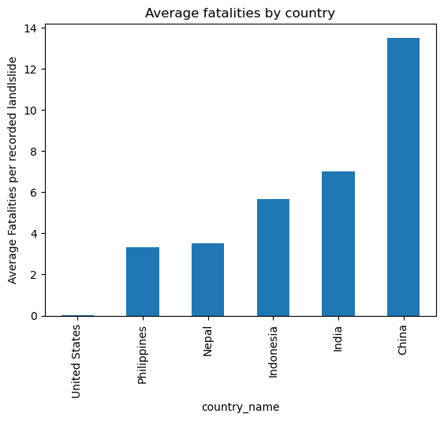
Countries with the deadliest landslides
GLOBAL LANDSLIDE CATALOG

Slide 14
GLOBAL LANDSLIDES DATA
SUMMARY

